Slide 1
CS 3006 Parallel and Distributed Computing Lecture 2
Danyal Farhat
FAST School of Computing
NUCES Lahore

Slide 2
Introduction to Parallel and Distributed Computing, Amdahl's Law and Karp-Flatt Metric

Slide 3
Outline
Motivation for Parallel and Distributed Computing
Need for Parallelism?
Moore’s Law
Doubling the transistors does doubles the speed?
Will Moore’s law hold forever?
Need for Parallel and Distributed Computing
Parallel and Distributed Systems
Distributed System vs Distributed Computing

Slide 4
Outline (Cont.)
Parallel Computing vs Distributed Computing
Practical Applications of P&D Computing
Scientific Applications
Commercial Applications
Computer Systems Applications
Parallel Computing Constraints / Scalability Issues

Slide 5
Outline (Cont.)
Amdahl’s Law
Karp-Flatt Metric
Exercises
Summary
Additional Resources

Slide 6

Motivation for Parallel and Distributed Computing
Uniprocessor are fast but
Some problems require too much computation
Some problems use too much data
Some problems have too many parameters to explore
For example
Weather simulations, online gaming, web servers, code breaking

Slide 7
Need for Parallelism?
Developing parallel hardware and software has traditionally been time and effort intensive
If one is to view this in the context of rapidly improving uniprocessor speeds, one is tempted to question the need for parallel computing
Latest trends in hardware design indicate that uni-processors may not be able to sustain the rate of realizable performance increments in the future
A number of fundamental physical and computational limitations
The emergence of standardized parallel programming environments, libraries, and hardware have significantly reduced time to develop (parallel) solution

Slide 8
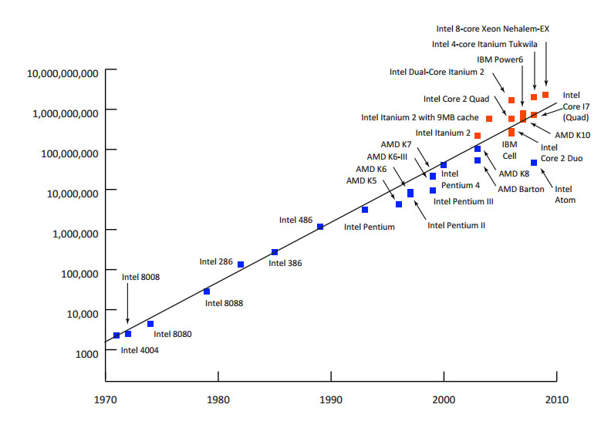
Moore’s Law
Number of transistors incorporated in a chip will approximately double every 18 months.

Slide 9
Moore’s Law (Cont.)
Doubling the transistors does doubles the speed?
True for single core chips but now the increase in number of transistor per processor is due to multi-core CPU’s
In multi-core CPUs, speed will depend on the proper utilization of these parallel resources
Will Moore’s law hold forever?
Adding multiple cores on single chip causes heat issues
Increasing the number of cores, may not be able to increase speeds [Due to inter-process interactions]
Transistors would eventually reach the limits of miniaturization at atomic levels

Slide 10
Need for Parallel and Distributed Computing
Need for:
Good parallel hardware
Good system software
Good sequential algorithms
Good parallel algorithms
Parallel and Distributed Systems

Slide 11
Parallel and Distributed Systems
Parallel and distributed computing is going to be more and more important
Dual and quad core processors are very common
Up to six and eight cores for each CPU
Multithreading is growing
Hardware structure or architecture is important for understanding how much it is possible to speed up beyond a single CPU
Also capability of compilers to generate efficient code is very important (e.g. converting for loop into threads)
It is always difficult to distinguish between HW and SW influences

Slide 12
Distributed System vs Distributed Computing
Distributed Systems:
“A collection of autonomous computers, connected through a network and distribution middleware.”
Enables computers to coordinate their activities and to share the resources of the system
The system is usually perceived as a single, integrated computing facility
Mostly concerned with the hardware-based accelerations

Slide 13
Distributed System vs Distributed Computing (Cont)
Distributed Computing:
“A specific use of distributed systems to split a large and complex processing into subparts and execute them in parallel to increase the productivity.”
Computing mainly concerned with software-based accelerations (i.e., designing and implementing algorithms)

Slide 14
Parallel vs Distributed Computing
Parallel Computing:
The term is usually used for developing concurrent solutions for following two types of the systems:
Multi-core Architecture
Many core architectures (i.e., GPU’s)
Distributed Computing:
The type of computing mainly concerned with developing algorithms for the distributed cluster systems
Here distributed means a geographical distance between the computers without any shared-Memory

Slide 15
Parallel vs Distributed Computing (Cont.)
Parallel Computing:
Shared memory
Multiprocessors
Processors share logical address spaces
Processors share physical memory
Referred to the study of parallel algorithms
Distributed Computing:
Distributed memory
Clusters of workstations
Processors do not share address space
There is no sharing of physical memory
Study of theoretical distributed algorithms or neural networks

Slide 16
Practical Applications of P&D Computing
Scientific Applications:
Functional and structural characterization of genes and proteins
Applications in astrophysics have explored the evolution of galaxies, thermonuclear processes, and the analysis of extremely large datasets from telescope
Advances in computational physics and chemistry have explored new materials, understanding of chemical pathways, and more efficient processes

Slide 17
Practical Applications of P&D Computing (Cont.)
Scientific Applications (Cont.):
Weather modeling for simulating the track of natural hazards like extreme cyclones (storms), flood prediction
Large Hydron Collider (LHC) at European Organization for Nuclear Research (CERN) generates petabytes of data for a single collision

Slide 18
Practical Applications of P&D Computing (Cont.)
Commercial Applications:
Some of the largest parallel computers power Wall Street!
Data mining analysis for optimizing business and marketing decisions
Large scale servers (mail and web servers) are often implemented using parallel and distributed platforms
Applications such as information retrieval and search are typically powered by large clusters

Slide 19
Practical Applications of P&D Computing (Cont.)
Computer Systems Applications:
Network intrusion detection: a large amount of data needs to be analyzed and processed
Cryptography (the art of writing or solving codes) employs parallel infrastructures and algorithms to solve complex codes – SHA 256
Graphics processing – Each pixel represents a binary
Embedded systems increasingly rely on distributed control algorithms - Modern automobiles use embedded systems

Slide 20
Parallel Computing Constraints / Scalability Issues
Parallel computing requires designing the proper communication and synchronization mechanisms between the processes and the sub-tasks.
Exploring the proper parallelism from a problem is a hectic process.
The program must have low coupling and high cohesion however it is difficult to create such programs.
Parallel computing needs relatively more technical skills to code a parallel program.

Slide 21
Amdahl’s Law
Amdahl’s law is a formula which gives the theoretical speedup in the execution of a task having fixed workload that can be expected of a system whose resources are improved (scalability)
Amdahl's law is used in parallel computing to predict the theoretical speedup when using multiple processors
Amdahl’s law is named after scientist Gene Amdahl, and was presented at the AFIPS Spring Joint Computer Conference in 1967

Slide 22
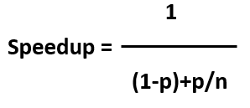
Amdahl’s Law (Cont.)
p is the ratio of “parallelizable code” over “total execution time”, from 0 to 1
n is the number of processors the code can use
If there are 4 processors and only 10% of the code is parallelizable
Speedup = 1/(0.9+(0.1/4))
= 1.081
that is only 8% with 4 processors!!

Slide 23
Amdahl’s Law (Cont.)
Scaling falls off as the number of processors increases due to lock (barriers for synchronizing masters and slaves) and memory collisions
It is very difficult to compute ‘p’
Serialized regions not only in our code, also in kernel and in HW
Private data cache of multiprocessor systems has to be kept consistent

Slide 24
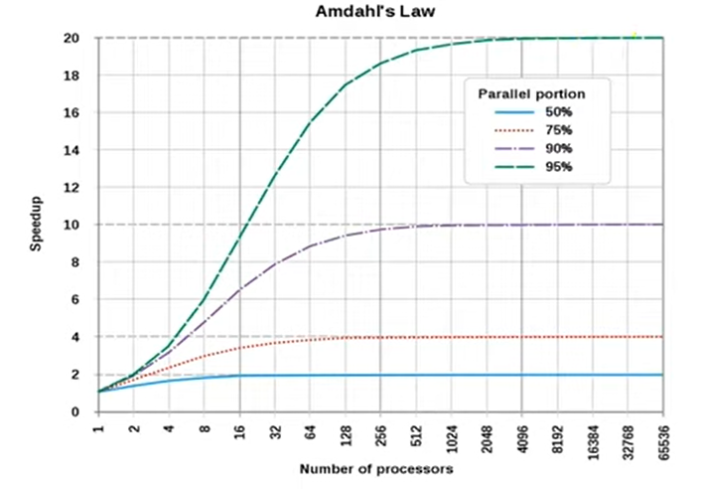
Amdahl’s Law (Cont.)

Slide 25
Amdahl’s Law (Cont.)
The performance improvement to be gained from using some faster mode of execution is limited by the fraction of the time the faster mode can be used.
Adding more processors will improve the performance only if the code to be executed can be equally parallelized.
Execution Time After Improvement = Execution Time Unaffected + ( Execution Time Affected / Amount of Improvement )

Slide 26
Karp-Flatt Metric
Amdahl’s law ignore the parallelization overhead due to which it overestimate the achievable speedup.
The Karp - Flatt metric is used to calculate serial fraction for a given parallel configuration.
Experimentally determined serial fraction 𝑒 takes into account parallel overhead.
Detects other sources of overhead or inefficiency ignored in speedup model
Process startup time
Process synchronization time
Imbalanced workload
Architectural overhead

Slide 27

Karp-Flatt Metric (Cont.)
If a parallel program is exhibiting a speedup S while using P processing units then experimentally determined serial fraction e is given by :
experimentally determined serial fraction 𝑒 may either stay constant with respect to 𝑝 (meaning that the parallelization overhead is negligible) or increase with respect to 𝑝 (meaning that parallelization overhead dominates the speedup )

Slide 28
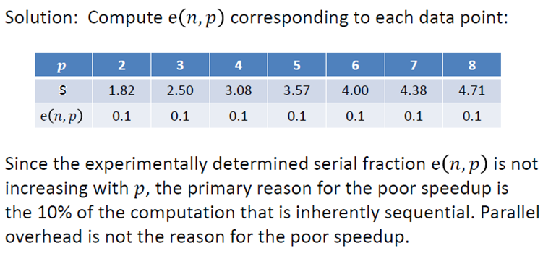
Exercises
Example: Suppose in a parallel program, for the given processors, you gained a speedup given in second row, determine sequential fraction of your program.

Slide 29
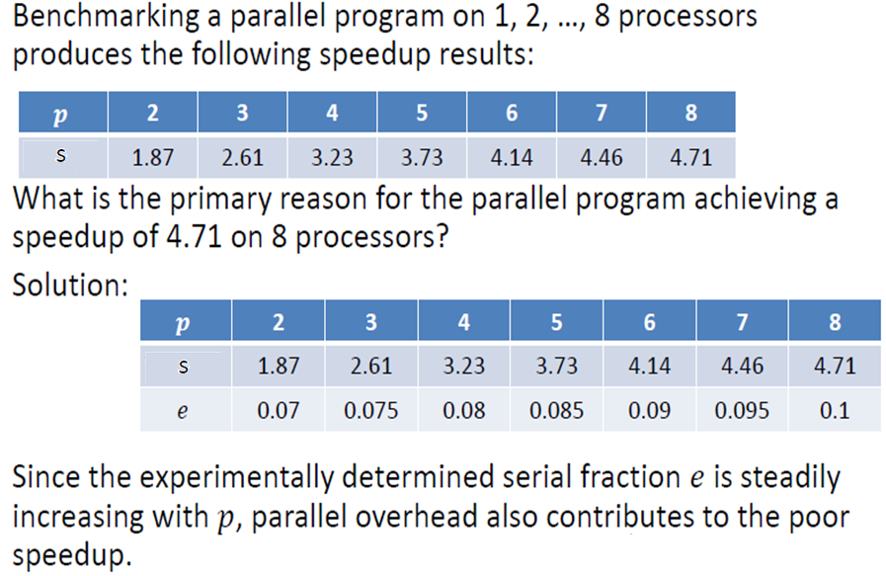
Exercises (Cont.)

Slide 30
Summary
Motivation for Parallel and Distributed Computing
Apps like weather simulations, online gaming, web servers etc. requires PDC
Need for Parallelism?
Uniprocessors cannot provide required performance due to theirs computational limitations
Moore’s Law - Number of transistors double every 18 months
Doubling the transistors does doubles the speed?
True for single core chip but not for multi-core CPUs
Will Moore’s law hold forever?
Heat issues, synchronization issues, limits of miniaturization of transistors

Slide 31
Summary (Cont.)
Need for Parallel and Distributed Computing
Good parallel hardware, system software, sequential algorithms, and parallel algorithms
Parallel and Distributed Systems
Hardware architecture is important to understand how much it is possible to speed up beyond a single CPU
Capability of compilers to generate efficient code is important (loop conversion into threads)
Difficult to distinguish between HW and SW influences

Slide 32
Summary (Cont.)
Distributed System vs Distributed Computing
Distributed System - Collection of autonomous computers, connected through a network and distribution middleware
Distributed Computing - Specific use of distributed systems to split a large problem into subparts and execute them in parallel
Parallel Computing vs Distributed Computing
Parallel Computing - Developing concurrent solutions
Distributed Computing - Autonomous computers on different locations connected via network

Slide 33
Summary (Cont.)
Practical Applications of P&D Computing
Scientific Applications - Characterization of genes and proteins, astrophysics applications, computational physics and chemistry, weather modeling, nuclear physics
Commercial Applications - Processing of stock exchanges, banking sector, business analytics, web servers, mail servers, search engines
Computer Systems Applications - Network intrusion detection, cryptography, graphic processing, embedded systems control
Parallel Computing Constraints / Scalability Issues
Parallel computing requires designing proper communication and synchronization mechanisms
Parallel program must have low coupling and high cohesion

Slide 34
Summary (Cont.)
Amdahl’s Law
Predict theoretical speedup when using improved resources
p: ratio of parallelizable code n: number of processors
Scaling falls off as the number of processors increases due to synchronization issues and parallel overhead

Slide 35
Summary (Cont.)
Karp-Flatt Metric
Calculate serial fraction for a given parallel configuration
Detects sources of overhead or inefficiency ignored in the speedup model
Process startup time, Process synchronization time
Imbalanced workload, Architectural overhead
e is constant with respect to p - parallelization overhead is negligible
e increases with respect to p - parallelization overhead dominates the speedup
Exercises

Slide 36
Additional Resources
Book: Introduction to Parallel Computing by Ananth Grama and Anshul Gupta
Chapter 1: Introduction to Parallel Computing
1.1 Motivating Parallelism
1.2 Scope of Parallel Computing
Chapter 5. Analytical Modeling of Parallel Programs
5.4 Scalability of Parallel Systems

Slide 37
Questions?

